Slide 1
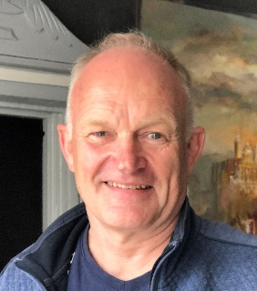

Build your own gas turbine performance model in Python
Tutorial of Basics
ASME IGTI TE 2025 Aircraft Engine Committee
Dr. Wilfried Visser
Oscar Kogenhop MSc

Slide 2
Overview
Introduction
System performance modelling
Propulsion and power systems
Software implementation
Example case: jet engine python model
Concluding remarks

Slide 3
For whom is this tutorial
Introduction
Engineers, scientists, researchers, students
With interest in system simulation of propulsion and power systems
Wanting to learn how system models work
Needing for models with new functionalities
Coupling with other models
Having basic coding skills

Slide 4
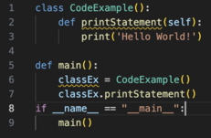
Key focus areas
Introduction
System modelling
Object orientation
Python programming language
Open-source libraries
Aero-thermal
Numerical methods
Data handling
Visualization

Slide 5
System performance modeling
System of interacting components
Relationships among system of interacting components
Component models
Equations
conservation of mass, energy, momentum, other…
mostly non-linear algebraic/differential
Component operating points
Defined by state variables
Solution of set of equations
State variable vector representing valid system operating point
Steady-state or transient

Slide 6
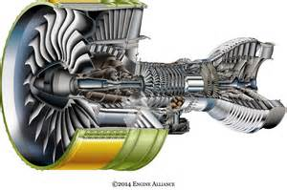
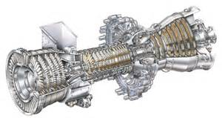
Propulsion and power systems
System performance modeling
Gas turbines
Aero engines: jet engines, turboprop, turboshaft
Land based engines: turboshaft
Propellers and rotors
Hybrid elements
Electric motors
Generators
Fuel cells
Batteries
Alternative/sustainable fuels

Slide 7

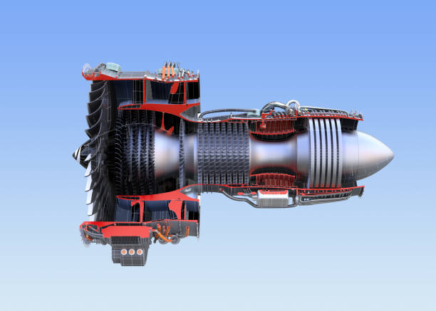

Propulsion and power system performance prediction
System performance modeling
Design studies
Existing designs

Slide 8
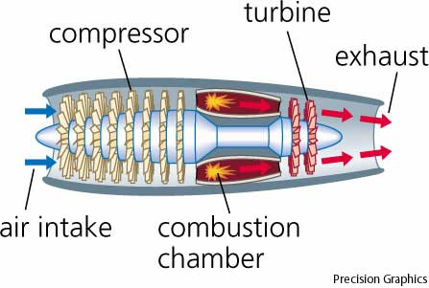
Gas turbine system performance models
System performance modeling
Components models
intake, fans/compressors, combustors, turbines, mixers, exhausts,
Component maps
State variables
Rotor speeds, mass flows, pressure ratios, …
Equations
Mass flow in = mass flow out (at component intersections, engine stations)
Power balance : PWcompressor = PWturbine
Input
Fuel flow, TIT, inlet P and T…
Output
Thrust FN, Power, Fuel flow, Efficiency, P, T at engine stations…

Slide 9
Relationships among component models
Software implementation
Ambient
Inlet, exhausts
Gas path
Gas conditions and flow rates between two connected components
Engine station numbering
Example: compressor – combustor, station nr. 3
Shafts
Power balance PW_{compressor} = PW_{turbine}
If no balance: transient (accel or decel)
Heat transfer
Control
Fuel flow, variable geometry

Slide 10
Design point simulation
System performance modeling
Design studies
Effects of cycle design parameters
e.g. PR, BPR, W, efficiencies
Varying dimensions
Simple
straight forward inlet to exhaust calculation
conservation of mass, energy, momentum
More complex
solving equations
constraints

Slide 11
Design point calculation example
Gas turbine performance models
Initialization:
Check model consistency
Build ordered component list CalcList
Single spool Turbojet
Start DP calculation through CalcList
Input
0
Output
P₀, T₀, Ma, W_{2des}
Inlet
Pt₂, Tt₂, FD
PR_{cdes}
η_{cdes}
2
Compressor
Pt₃, Tt₃, W₃
3
Manual Fuel Control
W_{fdes}
Combustor
Pt₄, Tt₄, W₄
4
η_{tdes}
Turbine
Pt₅, Tt₅, W₅
5
Ps₈, Ts₈,
A₈, FG
Exhaust nozzle
8
Post processing
FN, SFC
End of simulation

Slide 12
Off-design (‘OD’) simulation
System performance modeling
Analyze effects of operating conditions on performance
Fixed geometry and dimensions
*except for variable geometry features like VSVs, IGVs, Bleed valves
Requires initially calculated Design point
‘cycle reference point’ CRP
Predict how the operating point changes (from CRP) with operating conditions deviating from the design conditions
Steady-state equilibrium
Transient (change in time, accel/decel of rpm’s)

Slide 13
Equations and numerical methods
System performance modeling
Solve equations for a gas turbine engine steady-state or transient OD operating point
State variables
representing the operating point
minimal number of independent (or ‘tearing’) variables
other parameters can be directly/explicitly calculated from the state variable values
Find the OD operating point = find state variable values
Satisfying all conservation equations
Residuals (‘errors’) must all be 0
Single solution
n ‘error equations’ with n unknown ‘state variables’ (n degrees of freedom system)
Calculate all dependent other parameter values

Slide 14
Turbojet example - states
Off-design simulation
Required: 4 states S1..4
S1 = W2
S2 = PRc*
S3 = N
S4 = PRt
From the 4 states all other parameters can be calculated
*Instead of PR, usually Beta is used
2
3
4
5
8
0
C
N
0
W2
T
PRc
PRt

Slide 15
Turbojet example - equations
Off-design simulation
Satisfying conservation equations
To find the 4 unknown states we need 4 equations
E1 = Inlet mass flow - compressor mass flow (map) = 0
E2 = Compressor power + turbine power = 0
E3 = Combustor exit mass flow - turbine mass flow (map) = 0
E4 = Turbine mass flow - nozzle mass flow = 0
2
3
4
5
8
P5
0
E2
T5
0
C
T
E4
E1
E3

Slide 16






Off-design iteration flow chart - turbojet
Gas turbine performance models
Initialize: set map scale factors,
assign State variables (S) and Error functions (E), determine first J⁻¹
Define States And Errors
Input
Start OD calculation through CalcList
P₀, T₀, Ma
0
S[1]→W_{c2}
Inlet
S[2]→N
S[3]→βc
2
Compressor
$E\left[1\right]=\frac{W_{2}−W_{2map}}{W_{2des}}$
3
W_{f OD}
Manual Fuel Control
Combustor
$E\left[2\right]=\frac{{PW}_{t}∗η_{m}−PW_{c}}{PWtdes}$
$E\left[3\right]=\frac{W_{4}−W_{4map}}{W_{4des}}$
S[2]→N
S[4]→β_{t}
4
Turbine + map
5
${\overline{S}}_{i+1}={\overline{S}}_{i}+f.J^{−1}.{\overline{E}}_{i}$
Exhaust nozzle
$E\left[4\right]=\frac{W_{8}−W_{5}}{W_{8des}}$
8
y
$\frac{{\left(e_{i}\right)}^{2}}{{\left(e_{i−1}\right)}^{2}}<f_{pr}$
$max(\left|\overline{E}\right|)<ε$
n
n
y
OD performance
FN, SFC etc.
Post processing
Not enough progress
determine new J⁻¹
End of simulation

Slide 17
Recommended literature
W. Visser “Generic Analysis Methods for Gas Turbine Engine Performance: the development of the gas turbine simulation program GSP”, 6 January 2015, Delft University of Technology, ISBN 978-94-6259-492-0 (available from https://repository.tudelft.nl/islandora/object/uuid%3Af95da308-e7ef-47de-abf2-aedbfa30cf63 ).
H. I. H. Saravanamuttoo, G. F. C. Rogers and H. Cohen, Gas Turbine Theory, 5th ed.: Pearson Education, 2001.
Several authors and contributors, ‘AVT-018 Performance Prediction and Simulation of Gas Turbine Engine Operation’, NATO Research and Technology Organization 2003 RTO-TR-044
Walsh P.P, Fletcher P., Gas turbine Performance, ISBN-10: ‎ 063206434X ISBN-13 ‏ : ‎ 978-0632064342
Visser, W.P.J. and Broomhead M.J., 2000, ‘GSP, a generic object-oriented gas turbine simulation environment’, ASME paper 2000-GT-2, presented at the ASME TURBO EXPO 2000, 8-11 May 2000, Munich, Germany,
J. Kurzke, "Advanced User-friendly Gas Turbine Performance Calculations on a Personal Computer", 95-GT-147, presented at the ASME IGTI Turbo Expo, 1995.`
J. Kurzke, "How to get Component Maps for Aircraft Gas Turbine Performance Calculations", ASME Paper 96-GT-164, 1996.
W. P. J. Visser and I. D. Dountchev, "Modeling Thermal Effects on Performance of small Gas Turbines", GT2015-42744, to be presented at the ASME IGTI Turbo Expo 2015, Montreal, Canada, 2015.

Slide 18

New propulsion system model elements
System performance modeling
Sustainable fuels
Electric systems
Heat exchangers
Hybrid systems (gas turbines, fuel cells, batteries)
Generators, Electric motors driving fans and propellers
So, there is a need for
Extensions in modeling and simulation tools
Or, build tools from scratch ?

Slide 19

From scratch ?
System performance modeling
Things to think about
Why from scratch?
Will others use my code?
Will code be used later?
For other propulsion systems / engines?
Flexibility
Costs / Benefits of making the tool generic?
Add a user-friendly GUI?
?...
Save time and $ preparing your project
Select language, development platform
Design software architecture

Slide 20
Why from scratch?
System performance modeling
Pros
Full control and flexibility
“I know what I am doing”
Coupling with other models (1..4 D models)
Cons
A lot of work
Validation
Code maintenance / documentation
Code accessibility / readability to others
Especially ‘if you leave the company’

Slide 21

Software implementation
So, you have decided to start
from scratch!

Slide 22
Language / development environment
Software implementation
Python
Open-source programming language/development environment
Widely used by students, young engineers and scientists
Ready to use libraries for almost any engineering problem
Object orientation
Readable code
Development environments
Microsoft Visual Studio Code (‘VS Code’)
PyCharm
Platform? Windows, Linux, IOS?

Slide 23
Python versus previous experience
Software implementation
Gas turbine Simulation Program GSP
Developed at
Dutch National Aerospace Center NLR
Delft University of Technology
Object oriented, GUI
4GL development environment, 30 year legacy code
~120,000 lines of code (excluding library code)
Python “GSPy”
using open-source libraries
~ 1000 - 4000 lines of code !!!!

Slide 24
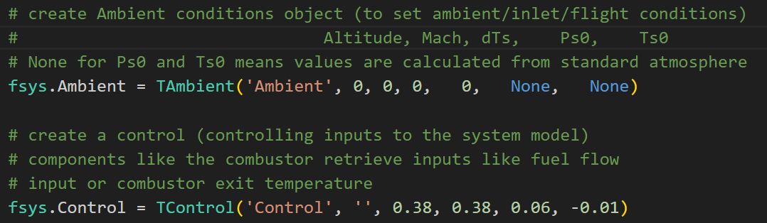
Working with Python models
Software implementation
Run code from development environment (no GUI)
Specify input in code
Example: specify Ambient conditions and a number of fuel flow steps
Adapt / extend code where needed

Slide 25
Python models overview
Software implementation
Object oriented architecture
Main program
Using open-source libraries
Component model implementations
Output of simulation results

Slide 26
Object orientation
Software implementation
3 main paradigms
Encapsulation
An object holds both data and ‘methods’ (procedures, functions) working with these and data, and also external data
Object class (class is ‘type’ of object)
Inheritance
An object can inherit data and methods from a ‘parent class’
Polymorphism
An object variable can represent objects from different classes inheriting from the same parent

Slide 27
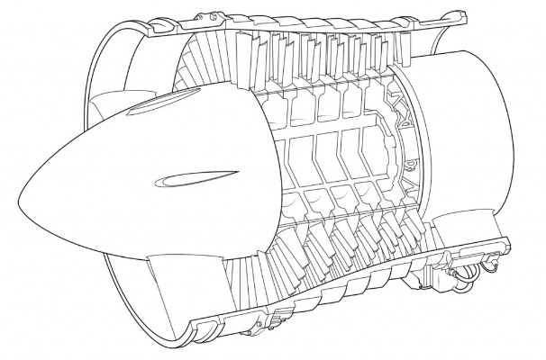
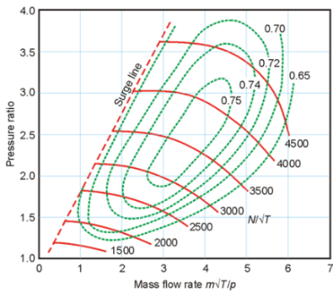
Encapsulation example
Object orientation
Compressor component model
compressor object class holds
W, PR, Eta, N
methods to calculate the compression process
Compressor performance map
Functions to communicate with the system model and other component models

Slide 28
Inheritance example
Gas path W, T, P in/out
Inlet
Turbomachinery N, PR, Eta, PW
Controls
Fuel control
Duct
Combustor fuel flow
….
Compressor compression
Turbine expansion
Fan splitter
….
Exhaust PR, thrust
instantiable class
abstract class
Generic component model class
Object orientation
legend
data
functions, procedures (algorithms)

Slide 29
Polymorphism example
Object orientation
Generic component model class object
‘abstract’ object that can represent any child object
has a generic ‘Run’ method (procedure or function)
Child classes inherit and ‘override’ the Run procedure with calculations actually simulating the process in the component
System model
List of objects (of instantiable classes)
E.g. Inlet-compressor-combustor-turbine-exhaust
System model simulation subsequently calls the ‘Run’ methods of all objects in the list, in this example calculating from inlet through exhaust….
Abstract Generic component model class
Encapsulation
An object holds both data and ‘methods’ (procedures, functions) working with these and data, and also external data
Object class (class is ‘type’ of object)
Inheritance
An object can inherit data and methods from a ‘parent class’
Polymorphism
An object variable can represent objects from different classes inheriting from the same parent

Slide 30
Polymorphism python code example
Object orientation
# create a turbojet model list of component models
turbojet = [TInlet( 'Inlet1', 19.9, 1 ),
TCompressor('compressor1', 1, 16540, 6.92, 0.825),
TCombustor( 'combustor1', 0.38, 0, 1, 1 ),
TTurbine( 'turbine1', 1, 16540, 0.88 ),
TDuct( 'exhaustduct', 1 ),
TExhaust( 'exhaust1', 1, 1, 1 )]
……
# comp is the abstract component object
for comp in turbojet:
q_gas = comp.Run(Mode, q_gas, Ambient)
Class
Name
Design/object data

Slide 31
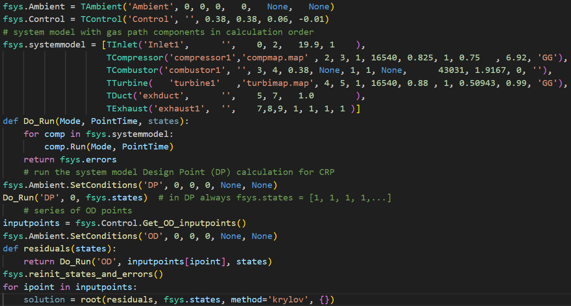
Main program for turbojet DP & OD simulation
Software implementation
Create Oper.conds.
(key code lines only)
Model creation &
definition
Procedure running
all comps.
DP simulation
OD simulation using root to
Find OD points

Slide 32
Model definition alternative
Software implementation
# Generic gas turbine components
inlet1 = TInlet('Inlet1', '', 0,2, 19.9, 1 )
duct1 = TDuct('exhduct', '', 5,7, 1.0 )
exhaust1 = TExhaust('exhaust1', '', 7,8,9, 1, 1, 1, 1 )
# ***************** Combustor ******************************************************
# fuel input
combustor1 = TCombustor('combustor1', '', 3, 4, 0.38, None, 1, 1, None, 43031, 1.9167, 0, '')
compressor1 = TCompressor('compressor1','compmap.map' , 2, 3, 1, 16540, 0.825, 1, 0.75 , 6.92, 'GG')
turbine1 = TTurbine( 'turbine1' ,'turbimap.map', 4, 5, 1, 16540, 0.88 , 1, 0.50943, 0.99, 'GG’)
fsys.systemmodel = [inlet1,
compressor1,
combustor1,
turbine1,
duct1,
exhaust1]

Slide 33
Passing gas conditions in Python
Software implementation
is run in order given in
list must be ordered such that component
gas path upstream conditions
other component/control parameters needed for “Run” have been calculated
Basic component “Run” code
# use dictionary for gas path conditions oriented by gas path station number
gaspath_conditions = {}
def Run(self, Mode, PointTime):
…
self.GasIn = fsys.gaspath_conditions[self.stationin]
…
# Calculate self.GasOut
…
fsys.gaspath_conditions[self.stationout] = self.GasOut
return self.GasOut

Slide 34
Python open-source libraries
Software implementation
Ready to use libraries
Standard atmosphere aero-calc
Thermodynamics cantera
Compression, expansion in compressors, turbine, exhausts, nozzles
Combustion chemical reactor model
Multidimensional arrays numpy
Numerical methods scipy
‘root’ generic solver (‘Krylov’ method)
Output data export
Export to .csv pandas
Make graphs in Excel

Slide 35
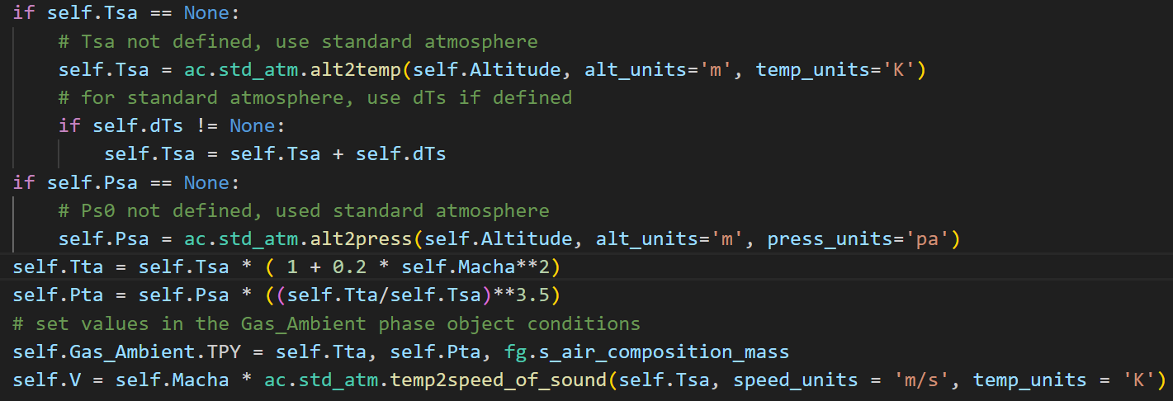
Aero-calc library
Software implementation
Aero-calc functions used for calculation of ambient/flight conditions from altitude, flight Mach, dT
alt2temp
alt2press
temp2speed_of_sound

Slide 36
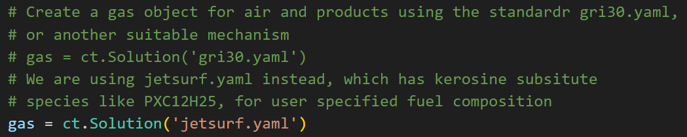
Cantera library
Software implementation
Open-source suite of tools for problems involving chemical kinetics, thermodynamics, and transport processes
https://cantera.org/index.html
Jetsurf machanism used for
Gas path transport
Compression/expansion
Combustion
https://web.stanford.edu/group/haiwanglab/JetSurF/JetSurF2.0/Index.html

Slide 37
Using Cantera (ct) gas model
Software implementation
define gas model
gas = ct.Solution('jetsurf.yaml’)
Set T, P, composition (mass mixing ratios)
gas.TPY = 1200, 101325, 'CH4:1, O2:2, N2:7.52’
Get T or P
P = gas.P
T = gas.T

Slide 38
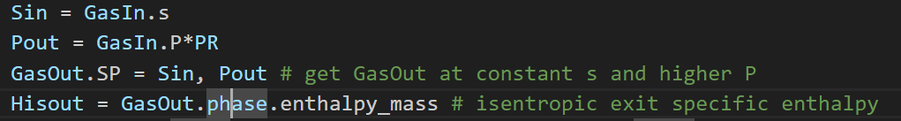
Using Cantera (ct) mass flow/transport
Software implementation
Define a quantity (mass flow) of gas
GasIn = ct.Quantity(gas, mass flow)
Set mass flow entropy or enthalpy and pressure
GasIn.SP = entropy value, pressure value
GasIn.HP = enthalpy value, pressure value
Isentropic compression of GasIn mass flow (with pressure ratio PR)

Slide 39
Using Cantera (ct) combustion
Software implementation
2 options for fuel specification
User specified composition (single species)
T and P
or
User specified LHV (mix of ‘unknown’ species, e.g. Kerosine, Jet-A)
T and P
average H/C and O/C ratio of the fuel molecules
In both cases end H, T, P and composition can be calculated

Slide 40
User specified fuel composition
Cantera - combustion
fuel = ct.Quantity(fg.gas) define fuel
fuel.mass = fuel mass flow fuel.TPY = T, P, FuelComposition define T, P, composition
GasOut = GasIn + fuel mix fuel with air
GasOut.equilibrate('HP’) chemical equilibrium combustion end state
T4 = GasOut.T get combustion end T (or H, S etc)

Slide 41
User specified LHV
Cantera - combustion
More complicated
Cannot use Equilibrate function
Need to calculate end composition from
Air composition
Fuel H/C and O/C ratios
Mole fractions book keeping (converting between mass – moles)

Slide 42
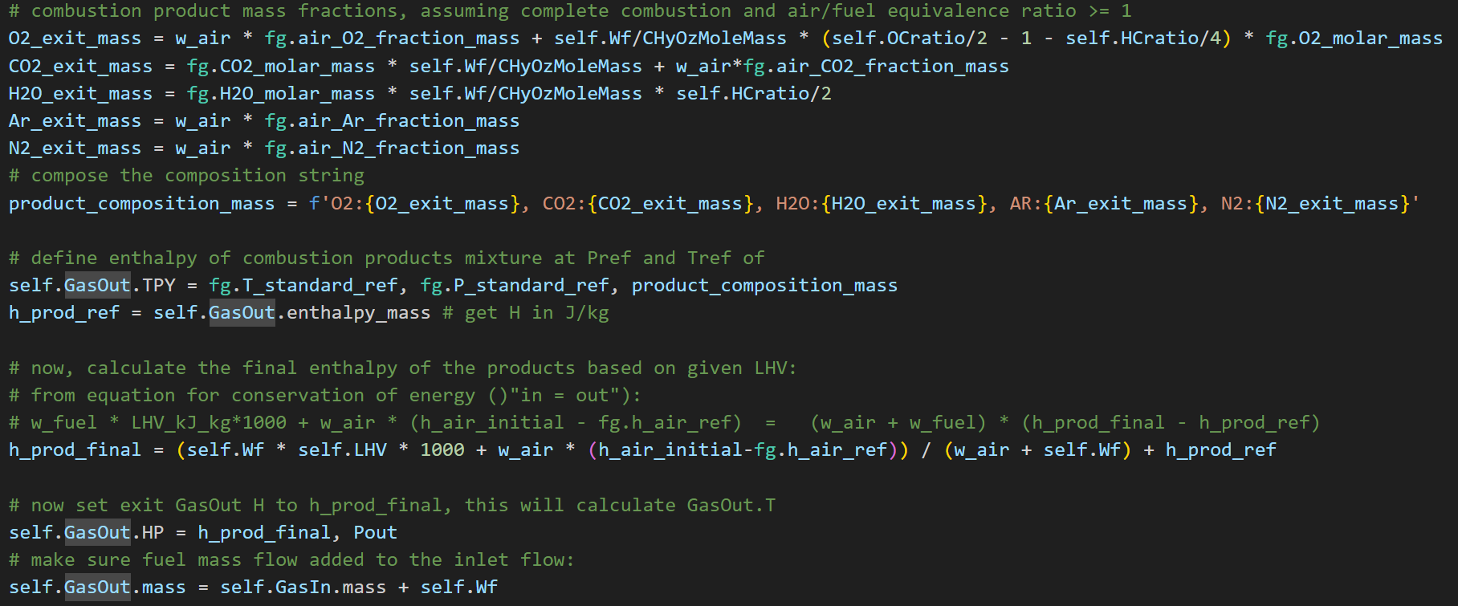
User specified LHV code
Cantera - combustion
Little bit more code lines:

Slide 43
Numpy and Scipy
Software implementation
https://docs.scipy.org/doc/
Numpy
multidimensional array operations
Scipy
solving system model non-linear algebraic/differential equations
using Root function
finding root of a vector function
> a valid system steady-state or transient point
newton-Raphson like iteration
several solver methods
Most suitable solver method ‘Krylov’

Slide 44
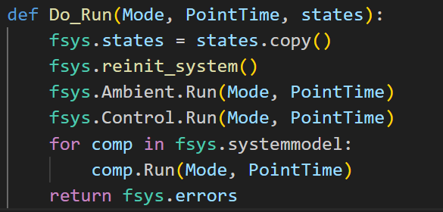
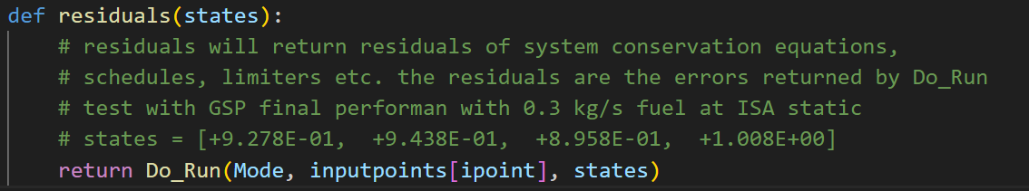
Solver code
Software implementation
Do_Run runs all component model code and returns the vector of equation errors (residuals)
residuals is the vector function (returns all 0’s if states is valid OP)
fsys.states = the initial value of the state vector
solution = the state vector representing a valid operating point

Slide 45
Component model implementations
Software implementation
Implementation of component performance maps
Inlets
Turbo machinery
Compressors
Fans
Combustors
Turbines
Ducts
Exhaust nozzles and diffusers

Slide 46
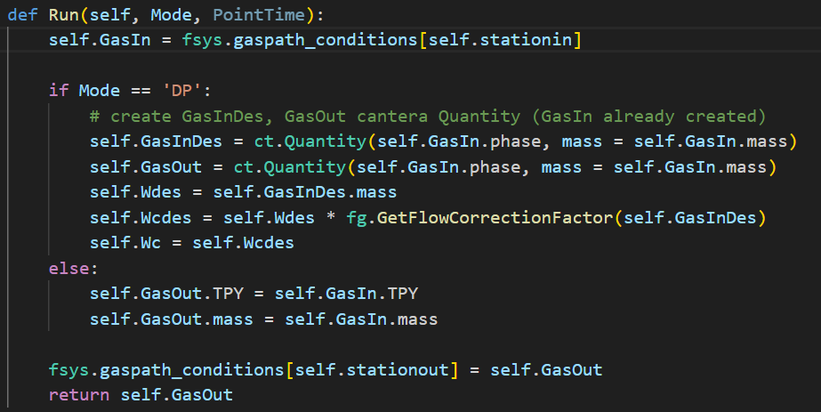
Gas path component (abstract)

Slide 47
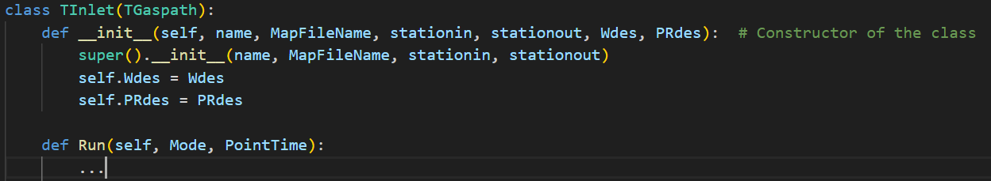
Gas path component “constructor” code
Component model implementations
Example: Tinlet declaration

Slide 48
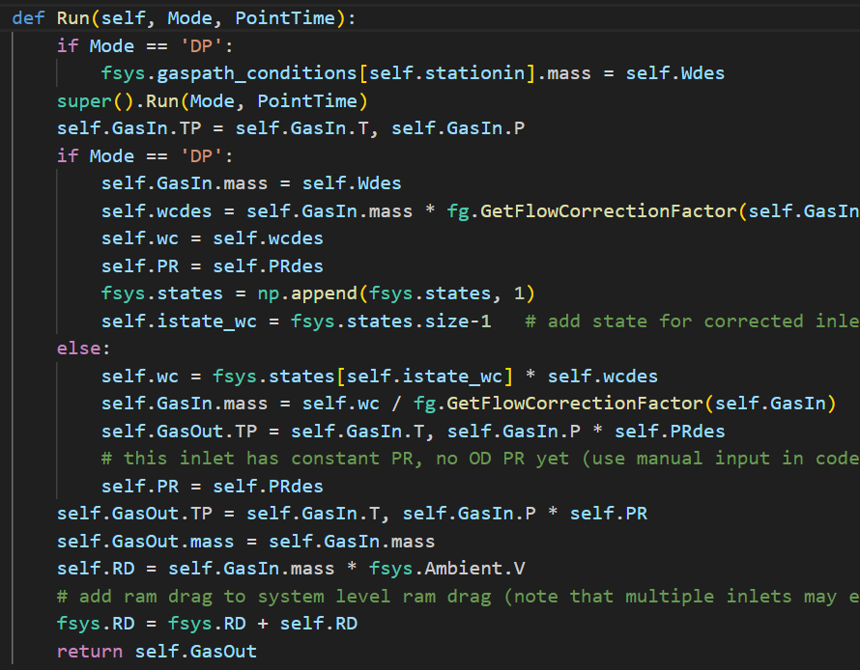
Inlet code
Component model implementations
Adding state variable

Slide 49
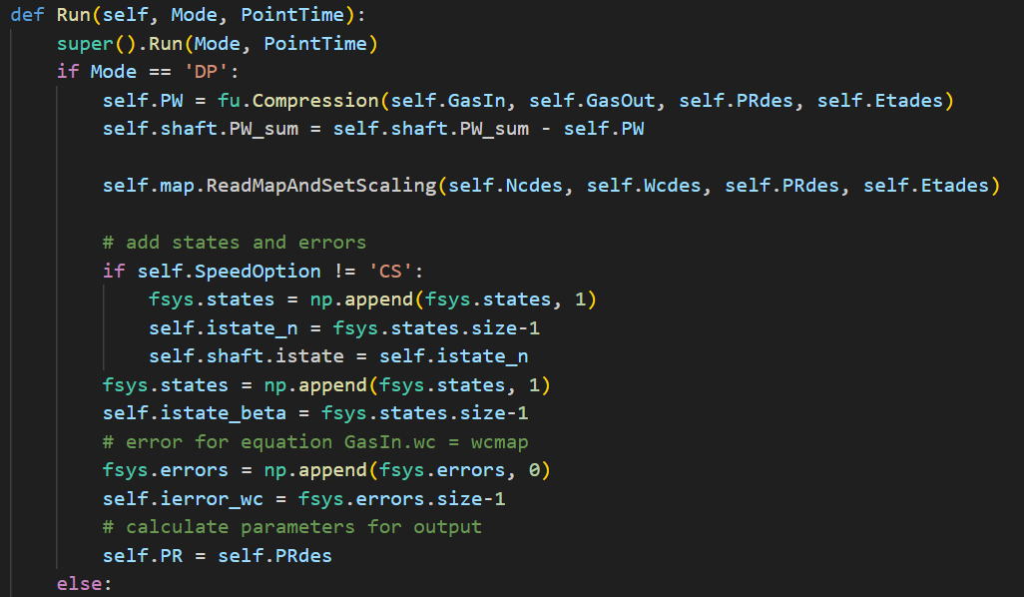
Compressor - Design point mode
Adding state variables
Adding error variable

Slide 50
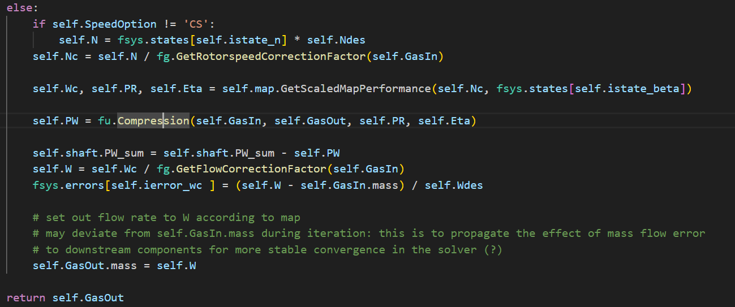
Compressor - Off-design mode
N from state var.
Beta from state var.
Compress. calc
error var. calc

Slide 51
Implementation other components
Software implementation
open-source TInlet and TCompressor code implementation
Using generic functions
Compression
Expansion
See open-source code for
Combustion (also see slides on Cantera)
Duct: simple pressure loss
Exhaust nozzle: isentropic expansion
Control
Ambient conditions (see slided on Aerocalc)

Slide 52
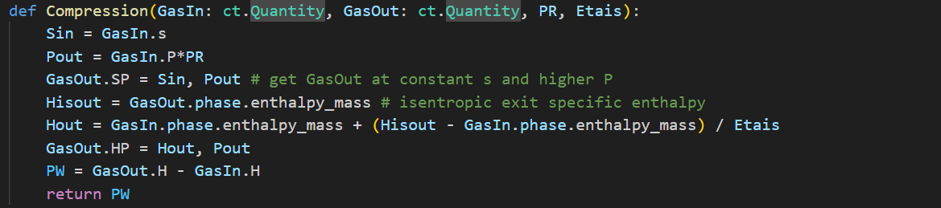
Compression code
Generic function used for calculating compressor or fan end conditions
Use Cantera for isentropic compression
Eta isentropic

Slide 53
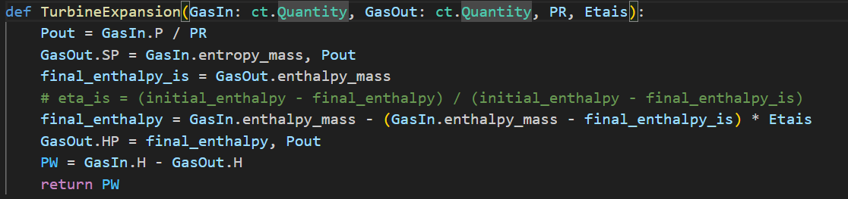
Turbine expansion code
Generic function used for calculating turbine end conditions
Use Cantera for isentropic expansion
Eta isentropic

Slide 54
Component characteristics or “maps”
Representing component performance
Tabular format
Examples
Simple: non-linear pressure loss relationship
Complex: turbo machinery maps:
fans, compressors, turbines,
Turbomachinery
Nc, Wc, PR, Eta, (Re)

Slide 55
Compressor / fan maps

Slide 56
Turbine maps

Slide 57
Map operation curve output

Slide 58
Python implementation - output
Software implementation
Generate global output table pandas
Code output per component
System level output (PW, FN, Wf, W2 etc.)
Export to .csv
Make graphs in Excel
Component maps
Graphical output matplotlib
Compessors, fans, turbines, …
Draw operating lines in maps
scaling

Slide 59
Demonstration
Running single spool turbojet model
Environment Microsoft VScode
Design + Off-design to IDLE at ISA SL
2 spool Turbofan

Slide 60
Adapting the baseline code
Software implementation
Other engine configurations
Turbofan
Mixer
Recuperator / heat exchanger
Turbogenerator
Polytropic efficiencies
Variable geometry
Secondary air flows (bleed flow, cooling flows)
Add propulsion system elements
Generators, electric motors, propulsors, batteries, fuel cells

Slide 61
Adapting the baseline code
Software implementation
Component model extensions
Variable geometry
Bleed
Turbine cooling
1-D model code
Other fuels
Easily adapt fuel in combustor component (cantera)

Slide 62
Adapting the baseline code
Software implementation
API (Application Programming Interface)
Couple with other models
Extend user interface
Extend output
Graphs, tables, export
Add GUI

Slide 63
Extending the models - 1
Software implementation
Fidelity
1-D component models
Turbomachinery
Combustors
Couple with multi-D CFD models
Gas turbine system
Control system
Fans, mixers
Recuperators
Application Programmers Interface API

Slide 64
Extending the models - 2
Software implementation
Propulsion system elements
Loads (propellers, generators)
Hybrid propulsion systems
Batteries
Fuel cells

Slide 65
Conclusion
Baseline open-source code available from
https://github.com/wvisser1958/gsppysim
Limited set of component model classes
Contact authors for advanced, extended versions
Dr. Wilfried Visser w.p.j.Visser@tudelft.nl
Oscar Kogenhop MSc oscar.kogenhop@epcor.nl

Slide 66
Questions?

